Slide 1


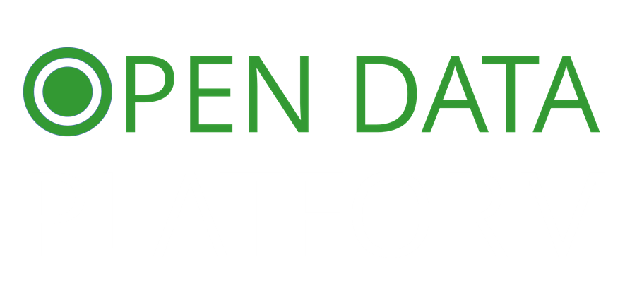


USE OPEN DATA PORTAL PAKISTAN TO PUBLISH AND SHARE DATA IN LESS THAN 60 SECONDS

Slide 2
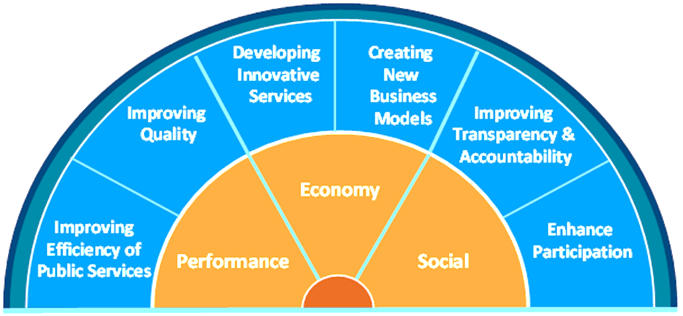
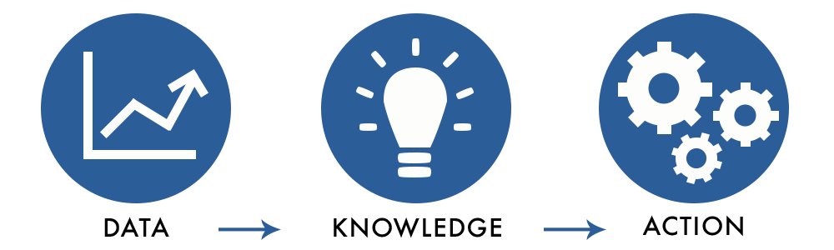
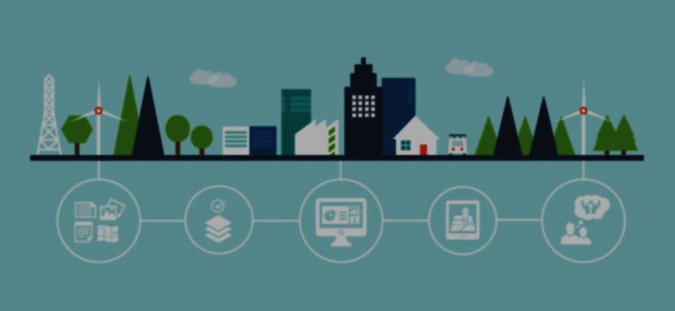

WHAT & WHY
Open data is data that can be freely used, re-used and redistributed by anyone

Slide 3
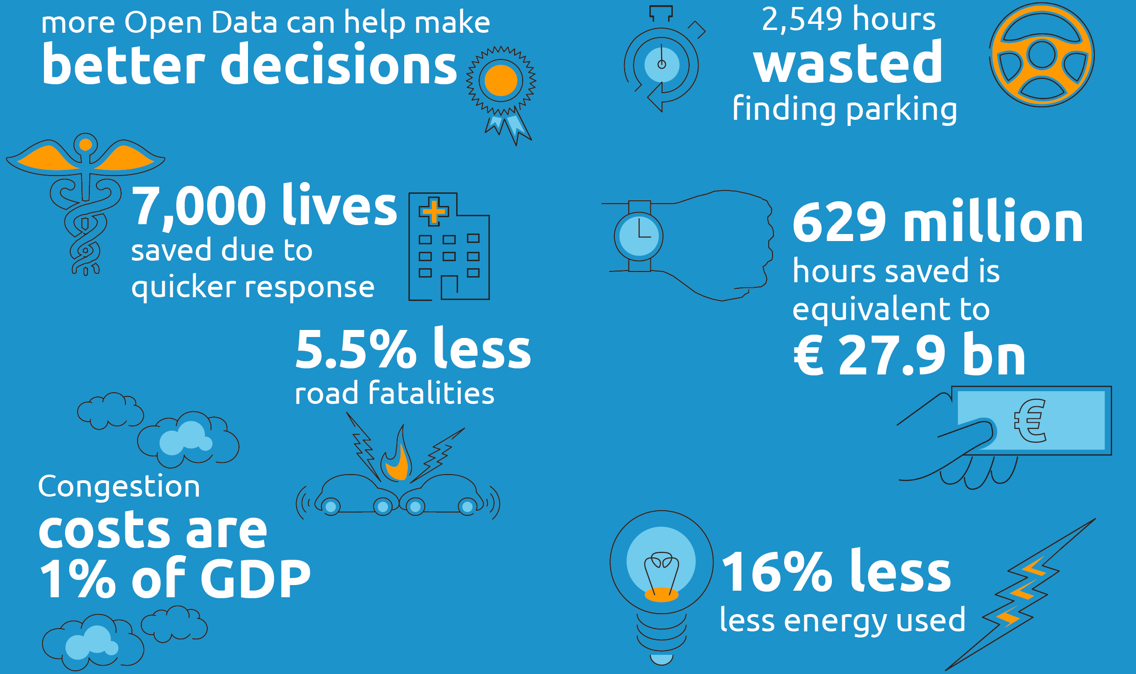

Slide 4

Putting things in context.
Open data saved Canada $3.2 billion in charity tax fraud.
Open data-driven global market worth up to $5tn a year
Open data-driven companies turn over £92bn
Improvements in malaria treatment
Accessing mental health support
Understanding government spending in Nigeria
Jobs for the less-privileged
New species discovered

Slide 5

ODP 2.o
ODP 1.o
Enterprise grade platform with interactive user experience that generate powerful visualizations automatically.
Interacts with your ecosystem and engages citizens through our built-in social features and feedback channels.
Free platforms and certified datasets. Upload and publish in less than 60 seconds.
PLATFORM ROADMAP

Slide 6

FIND OR PUBLISH A DATASET
STORE AND MANAGE DATA
ENGAGE WITH USERS & OTHERS
COSTOMIZE AND EXTEND

Slide 7



FEATURES
Ease of Use at the Core
ODP is designed to be intuitive for both data publishers and re-users. You’ll finally mean it when you say you’re open and transparent.
Leverage Powerful APIs
Don’t just search for a dataset, query within your data! ODP’S APIs even allow users to process data from IoT sources in real time.
Take full control
ODP’s front end is entirely open-source, allowing you to build your own custom and interactive dashboards to make your data speak.

Slide 8

OPEN DATA PLATFORM PAKISTAN TO GO-LIVE ON
14TH AUGUST 2017

